Slide 1
INTRODUCTION TO DATA SCIENCE

Slide 2
CONTENTS
What is Data Science?
Why should study Data Science?
How Does Data Science Impact Organizations?
Application and Competitive Advantage of Data Science in Organization
Importance of Data Science to Society
Road to Become a Data Scientist

Slide 3
What is Data Science?
A multi-disciplinary field that uses scientific methods, processes, algorithms and systems to extract knowledge and insights from structured and unstructured data.

Slide 4
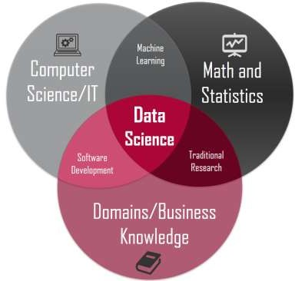
What is Data Science?
a "concept to unify statistics, data analysis, machine learning and their related methods" in order to "understand and analyse actual phenomena" with data.
employs techniques and theories drawn from many fields within the context of mathematics, statistics, computer science, and information science.

Slide 5
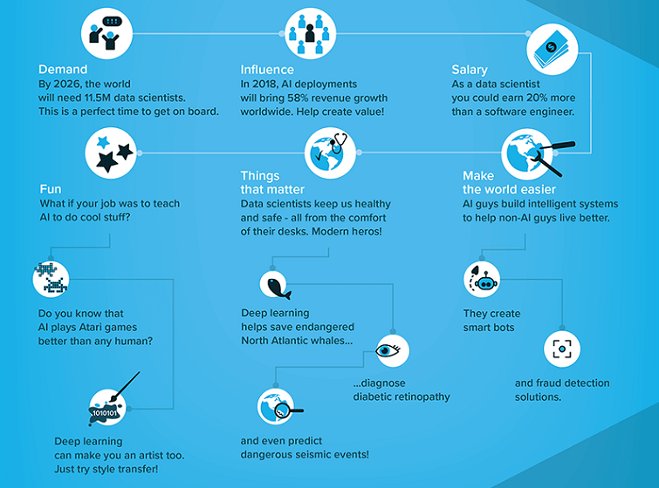
Why should study Data Science?

Slide 6
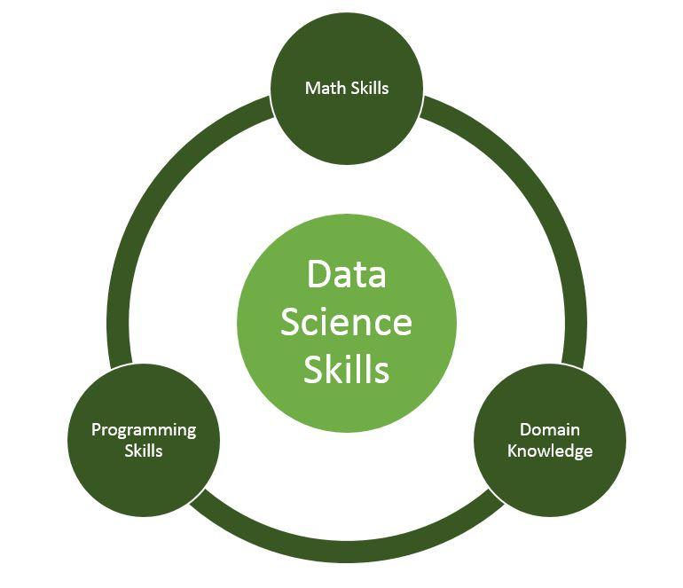
How to become a data scientist?
Let’s find out what the skills required are:

Slide 7
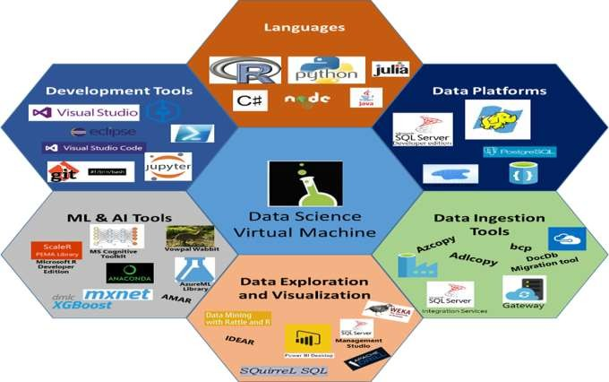
How to become a data scientist?
Other languages, tools, platforms and visualization

Slide 8
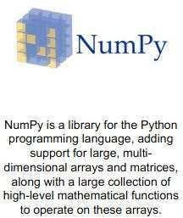
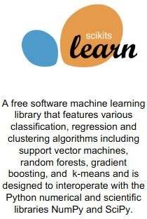
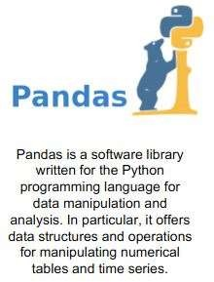
How to become a data scientist?
Learning Data Science with Python - Libraries

Slide 9
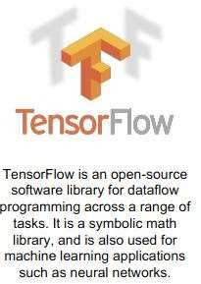
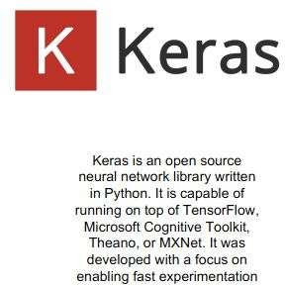
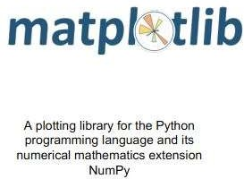
How to become a data scientist?

Slide 10
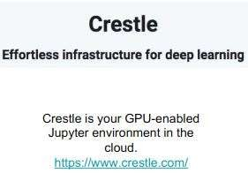
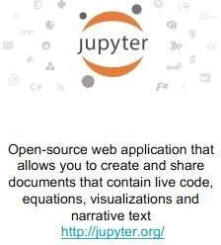

How to become a data scientist?

Slide 11
APPLICATION OF DATA SCIENCE
Security
Banking and Finance
Internet Search
Recommender System
Image Processing
Speech Recognition
Gaming
Airline Routing Planning
Fraud and Risk Detection
Delivery Logistics
Internet of Things (IoT)
Health Care
Augmented Reality
Self-Driving Cars

Slide 12
IMPACT OF DATA SCIENCE ON SOCIETY
Data-Driven Hospitals
Be thoughtful in professional work
Consider solutions to real-world problems that you encounter
Saving Energy

Slide 13
IMPORTANCE OF DATA SCIENCE
Data science helps brands to understand their customers in a much enhanced and empowered manner.
It allows brands to communicate their story in such a engaging and powerful manner.
Big Data is a new field that is constantly growing and evolving.
Its findings and results can be applied to almost any sector like travel, healthcare and education among others.
Data science is accessible to almost all sectors.

